Slide 1

My Journey Learning Flutter
Don Ward
Sr. Research Engineer
donward@quickenloans.com
@donwardpeng
Notes:
Good morning, my name is Don Ward.
I am a Sr Research Engineer at Quicken Loans on the Emerging Tech Team. Today I am going to talk about how to keep up with technology and my journey.

Slide 2

technology
moves fast
Notes:
So here is the thing - Technology has never moved so fast as it does today. Today there are a record number of people working to solve every problem imaginable using technology.

Slide 3

Notes:
As people that work with technology, we are paid for our knowledge and how we solve problems using that knowledge.
A big part of coming up with a solution for a problem is having the tools to do so. I am not talking about the software development environments or computers, I am talking about having the confidence, experience and skills needed to build with them. Confidence and experience are a key part of solving problems.
Let’s talk a bit about what I have learned about technology...

Slide 4

from
going
Notes:
Let's go back in time - earlier this year, I went from leading a team at QL to...

Slide 5

this
to
Notes:
...becoming a Sr Research Engineer.
One of my responsibilities was coding and solving problems.
I quickly realized that the proximity to technology I had over the years as a leader was not enough.
Proximity does not equate to code.
There were a few hard truths I quickly learned as a result of this.

Slide 6
Notes:
One hard truth that I learned - look at this - here is my typical day – look at the amount of time I have to myself. TV Time is really it – 2 hours I could possibly adjust in my day.

Slide 7

something to be
proud
of
Notes:
Another thing hard truth – most learning programs give you nothing at the end but a head full of knowledge - I wanted something to be proud of at the end.

Slide 8

good
news
Notes:
So here is the good news – I found a way to ‘level up’.
A lot of smart people have done it. It’s called the 100 Days of Code Challenge and I want to tell you how it helped me.
Before I jump in, let me tell you a bit about how I found the 100 Days of Code Challenge.

Slide 9

journey
my
My Journey
Notes:
As I entered my new role, one of the first things I thought would be helpful would to learn was a new programming framework. Since I am on the Emerging Tech team, I thought I would learn something that was up and coming.
Additionally, I came from a mobile development background so I felt comfortable with mobile development paradigms and the parlance of how apps are built.
So as I entered my new role, I decided I wanted to leverage a bit of what I knew and also learn a new emerging technology. I decided by doing this I could give back some of what I learned to my new team as well as get in on some new tech.
I choose a mobile development Framework called Flutter.

Slide 10

https://github.com/donwardpeng/DevOne.US-Conference
Notes:
I picked something that I was a bit familiar with as well as something that was shiny and new.
I picked a new mobile development framework called Flutter which in a nutshell allows for mobile apps for iOS and Android devices to be created from only one codebase.
It is pretty cool, and I was excited to kick the tires and start learning about it.
So what is Flutter,
Cross platform for Android, iOS, Web and ChromeOS
Performant – uses a Canvas
Backed by Google
Written in Dart
Apps like Abbey Road’s app, Hamilton the Broadway Musical, and Alibaba’s app are written in it.
Reflectly is also written in it – feature app of the day in Apple App Store recently.
Very active development:
Dec 2018 – V1.0
Today – V1.9
Next big event

Slide 11
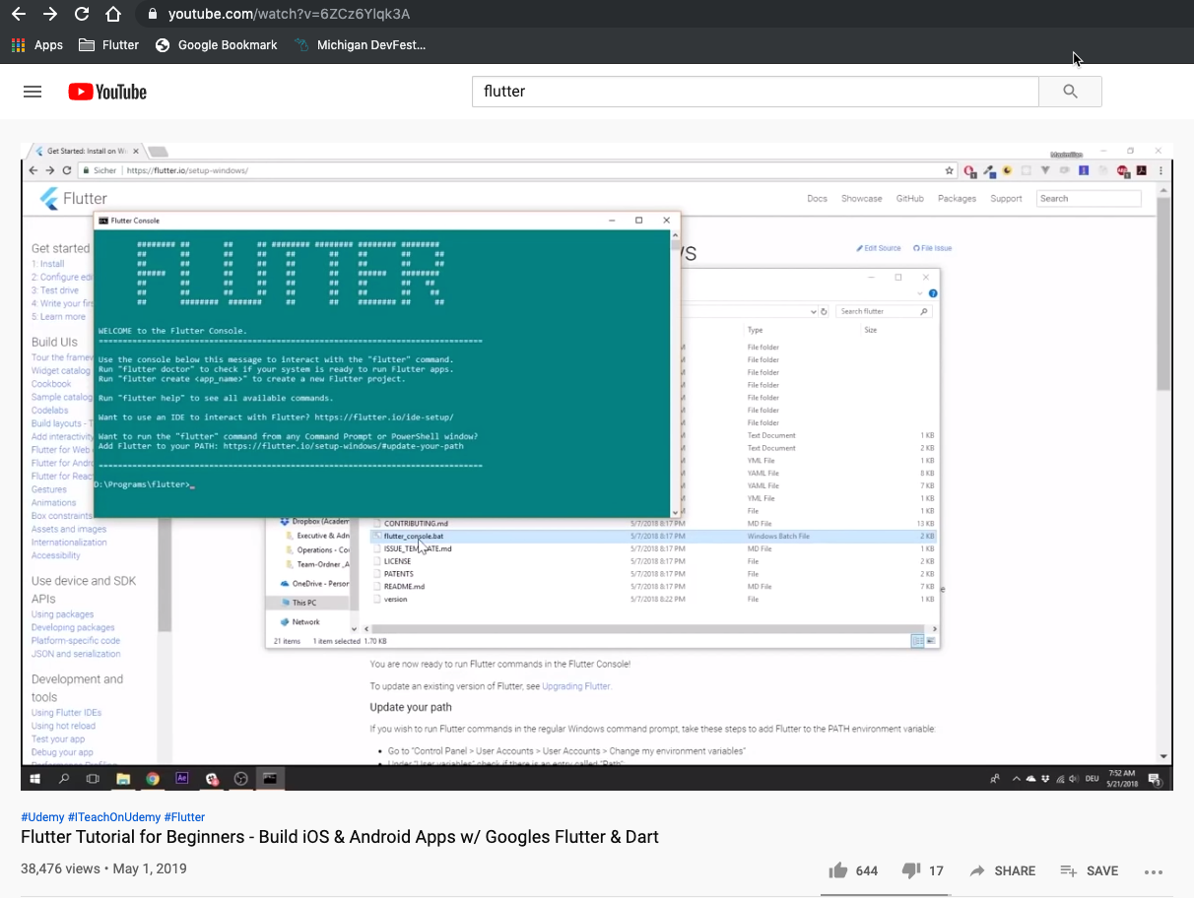
Notes:
So where did I start?
To the Internet!
I started with a video tutorial on YouTube on Flutter. I looked really good, and was paced well. The creator seems to understand the in's and out's of the framework and did not go to fast for me.
The issue was - it only lasted a few days. I got too distracted and as we layered learnings on top of learnings, the memorization of it all was done was not helping me. I needed to tackle problems myself to learn

Slide 12
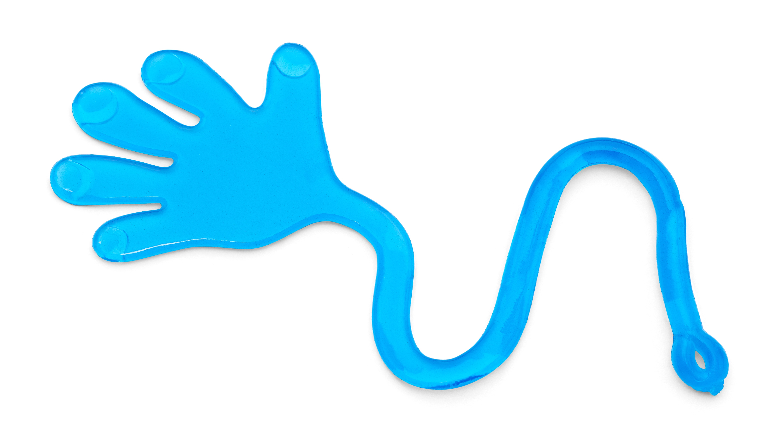
Notes:
Here's the thing - video and being shown how to build using a technology was not working for me.
I needed something stickier – something that was more self-directed. I tried Udacity courses, Coursera courses, online videos, but none of it stuck. I retain stuff by experience and recalling how I solved problems – courses were not cutting it. Then I learned about a thing called the #100Days of Code challenge.

Slide 13

#100DaysOfCode
Notes:
The #100DaysOfCode Challenge was something I found randomly online and as I learned more, I thought they might be on to something here.
So the challenge boils down to this – build something valuable outside of your day to day work using 1 hour a day – keep a log of your time, what your learned and share it on social media.
For a software developer, this would be coding for 1 hour a day. They recommend using Git to log your time with a template they provide. Additionally you can commit your code each day if you want. As for social media everyone seems to use Twitter for this.

Slide 14

forgiveness
build something
let the world know
Notes:
So I like to think of the #100DaysOfCode challenge as having 3 simple rules.
Forgiveness – you can miss one day every 2 weeks. I did not follow this to a T, but did my best to.
You need to build something of value since this is going to help keep you hooked. It also mimics real world conditions since rarely will you build something at work that does not provide value. I know this can be hard since what to build might not be readily apparent, but once you start learning a new skills, I find the ideas do not stop.
Let the world know – Tweet your progress. Use the hashtag #100DaysOfCode. You will find there are 1000’s of people doing the challenge at any given time and if you look for that hashtag in your feed after you have tweeted it, you will see the community out there.
13:50 minutes

Slide 15
Nothing can beat self-directed effort toward learning or accomplishing something...”
Alex Kallaway
-founder of the 100 Days of Code Challenge
Notes:
So why 100 Days, why do it? Why self-directed – I like this quote from Alex Kalaway on the #100DaysOfCode challenge – ““Nothing can beat self-directed effort toward learning or accomplishing something...”
This speaks to me – if I own it, it is that much more exciting. There is no set path, I am learning purely to learn. How do I know I am learning the right thing, that really boils down to the questions I ask and what I define as accomplishing something.
For a bit of context, Alex Kallaway is from Toronto and founded the 100DaysOfCode movement in 2016 with one blog post. Today thousands of people are working through it everyday.

Slide 16
MY 100 DAYS OF CODE
ML TOO?
YES - FLUTTER
DAY 0
DAY 3
DAY 7
DAY 1
DAY 5
STARTED
FLUTTER ONLY?
TOUGHER NOW
Notes:
So there I was – I just learned about this random thing - the #100DaysOfCode challenge.
The idea resonated with me, so I figured what have got to lose? I jumped right in – which can be a blessing and a curse for me.
Here is what the first seven days looked like from the log of the 100 Days.
Day 0 – I started a Flutter project since that is what I wanted to learn.
Day 1 – What?!? I also started a ML project. Another bad habit of mine is wanting to learn it all and overextending myself.
Day 3 – I decided to go back to Flutter
Day 5 – I doubled down – yes only Flutter for the next 100 Days.
Day 7 – What was I thinking 7 days ago? Things just got harder – for one it was my wife’s B’Day so I was not going to code, and got a new puppy. Sleep deprivation sets in, and my 2 hours a day starts looking like 30 minutes....

Slide 17
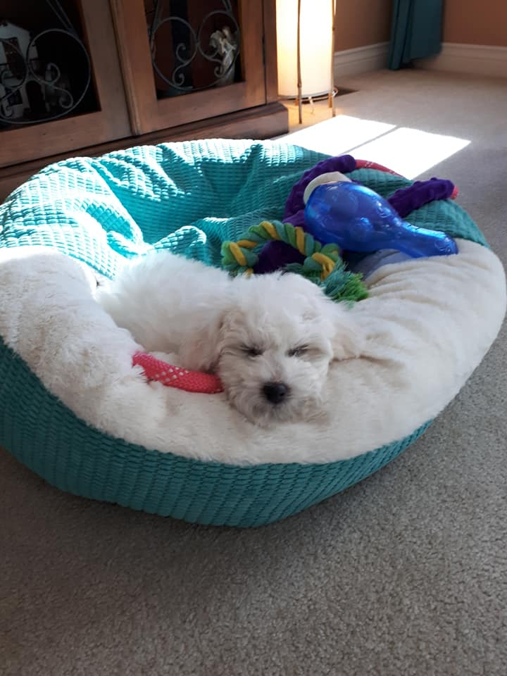
Notes:
Tougher now because of this guy.

Slide 18
MY 100 DAYS OF CODE
START AGAIN
DETOUR
DAY 12
DAY 28
DAY 49
DAY 18
DAY 32
FILE -> NEW PROJECT
WHICH IDE?
PUSH SAVE
Notes:
Continuing on,
Day 12 – I realized I really broke everything and was in over my head. I screwed the entire project up – File-> New Project
Day 18 – I did not learn my lesson on Day 12 – let’s try this again– File -> New Project
Day 28 – changed IDE’s since it looked shiny and new
Day 32 – I decided to try out a competing technology called React Native. Why? I wanted to be able to know with certainty that after 32 days of doing this, I had made the right decision in picking Flutter. Probably should have did this earlier, but as I mentioned I like to jump into things. I spent a few days working with React Native before going back to Flutter.
Day 49 – 57 – One of the craziest experiences for me. I spent 6 days on one problem. Here is the scenario – I had a mobile app that was talking with a backend service to get it’s data. One feature of the backend service was the ability to set the theme for the mobile app. For instance, if it is summer, maybe the mobile app uses summer colors like blues, and greens within it. If fall comes along, you should be able to just change one value in the backend service and the mobile app uses fall colours now – oranges and yellows. This is called remote config and is a pretty cool feature to have in a mobile app. So I started on this and it looked straightforward to implement. Basically add some code to the mobile app – literally it was copy and paste and wire it up on the backend service. Should take no more than ½ hour tops. It took me six days to get this working. I could not figure it out – I had my mobile app running on my phone, and would change the value on the website for the backend and nothing. I scanned the code, put in breakpoints, did everything I knew how to do for 6 days – it is all in my log. It was until the 6th day that I realized on the backend website that it was not just enough to change the value, there was a ‘Publish’ button down at the button of the page that you needed to press. I pressed it and voila – it all worked.
Let’s just say sometimes self-directed learning can be hard.

Slide 19
MY 100 DAYS OF CODE
FLUTTER WEB
SMALL VICTORY
DAY 58
DAY 79
DAY 100
DAY 62
DAY 86
TEACH IT
IT CAN NOT BE DONE...
DONE!
Notes:
So let’s continue on,
Day 58 – I was feeling pretty confident in my new found skills and subsequently taught a 45 minute intro to flutter to a group of university students at a user group meeting. It was fun to
1. Try and answer their questions
2. Validate that I had learned something well enough to explain it to someone else
Day 62 – I finished my mobile apps as far as I wanted to take it and decide to try something still in official preview - Flutter for Web. This consists of building a web app from the same codebase used to build a mobile app and sounded incredibly powerful.
Day 79 – So since Flutter for web was an official preview there were things that did not work yet – I figured, let’s see if I can get them to work. I spent a few days trying to fill these gaps, unfortunately did not make much of a dent but I learned a ton as I was forced to debug and dig deep into this stuff.
Day 87 – A small victory for me - I was able to parse data to power the website content from external sources – this allowed others to add content to it with a recompile and deploy
Day 100 – DONE – still continued to work on

Slide 20

sounds like a lot of rules…
Notes:
Let’s let’s talk about you.
One thing you might be thinking is,
is sounds like a lot of rules.

Slide 21
just
relax
Notes:
To which I would response – relax.
One of the tenants I like about it is there is some forgiveness. Let me re-iterate – this is just a tool to get you there. If you miss a few days, go on a detour or totally change direction, it is all learning and that is what you need to focus on.

Slide 22
I totally suck with commitments
Notes:
Ok – another thing you are probably thinking.
I suck at commitments.

Slide 23
build
momentum
Notes:
As with all things, getting started is hard, but 10 days in there was no way I was stopping. Even after 7 days I was hooked – my entry for Day 7 – got a new puppy and it was my wife’s birthday still did not stop me.
I just started the 100DaysOfCode again and I will admit it was tough to build the momentum at first, but overall it is worth it.

Slide 24
sounds a lot like work…
Notes:
Another thing you are probably thinking – it sounds like a lot of work.

Slide 25
work
fun
Notes:
I will not deny it is work – to me it was fun work.
Here’s the thing – ownership and the sense of accomplishment that comes with build something trumps the work aspect of it for me and my guess is that applies at some level to everyone in technology.

Slide 26
I have NO friends on twitter!
Notes:
Ok this one is fun – at the end of everyday, you tweet out you progress.
What if you have no friends on Twitter?

Slide 27
this is a
movement
Notes:
This is a movement.
Even if you have no friends on Twitter – there is a twitter bot in place that retweets every time someone tweets the #100DaysOfCode. Now you have a friend.
In all seriousness, there are 100’s maybe 1000’s of people doing this at a given time and most likely someone will like and retweet what you tweet everyday. We all feed off each other’s progress and failures. There are fun tweets out there about what people struggle with and overall it is pretty cool to watch your daily tweets take on a life of their own within the movement.

Slide 28
aren't all the cool ideas already built?
Notes:
ok – but aren’t all the cool ideas already built?

Slide 29

Notes:
Start and see. When you dig into a new technology the ideas do not stop coming.
After 62 days – I found a perfect use case for all of my new skills – building a website for a conference I was hosting.
When you have the skills and know the details – the ideas come quick

Slide 30
will this make me rich?
Notes:
How about this one – will this make me rich?

Slide 31
build a
reputation
Notes:
Not likely – it will help you build a reputation
I taught a course on Flutter at Day 28
Tweeting it every day – people notice
I had an acquaintance reach out with a Startup idea based on what they saw I was doing

Slide 32
the last time I coded we used floppy disks
Notes:
And for some of you the question arises - The last time I coded we used floppy disks.

Slide 33
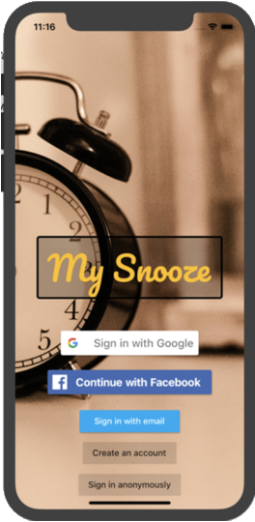
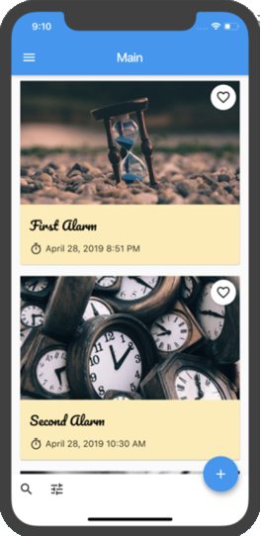
mobile
app
Notes:
I was close to being there. Look at this – I finished it with a mobile app and

Slide 34
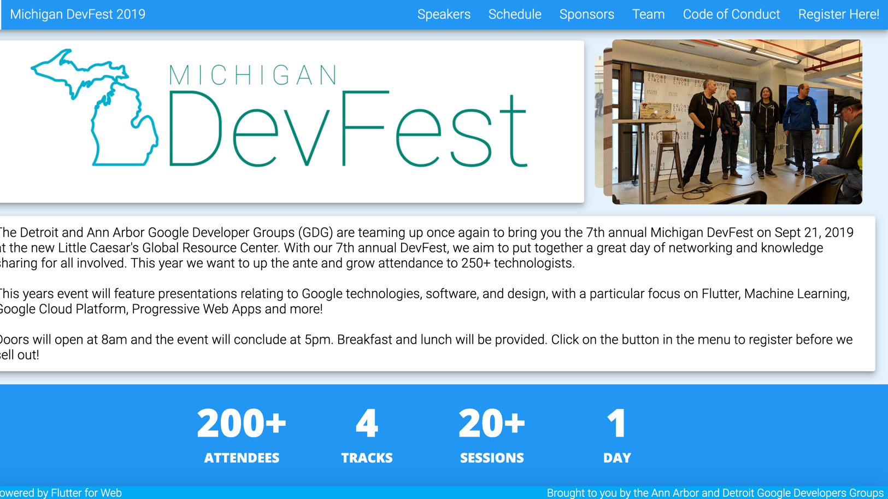
https://github.com/donwardpeng/midevfest
Notes:
website. The website is in production and was used for a conference I helped host a few weeks ago. It was fully functional.

Slide 35
where should I start?
Notes:
Last question - where should I start?

Slide 36
Notes:
freeCodeCamp Front End Developer course is a perfect start

Slide 37
join
me!
Notes:
Alex started a movement with a blog post. What would happen if everyone here started this.
Everyone here can do this – no matter what your skill level is or where you are right now.
What would happen if your team did this?
What would happen if this was applied to other areas of your life.
I started this again recently and would encourage you to join me. Let’s celebrate your accomplishment 100 days from now.

Slide 38
Thank you!
Don Ward
Sr. Research Engineer
donward@quickenloans.com
@donwardpeng

